Slide 1
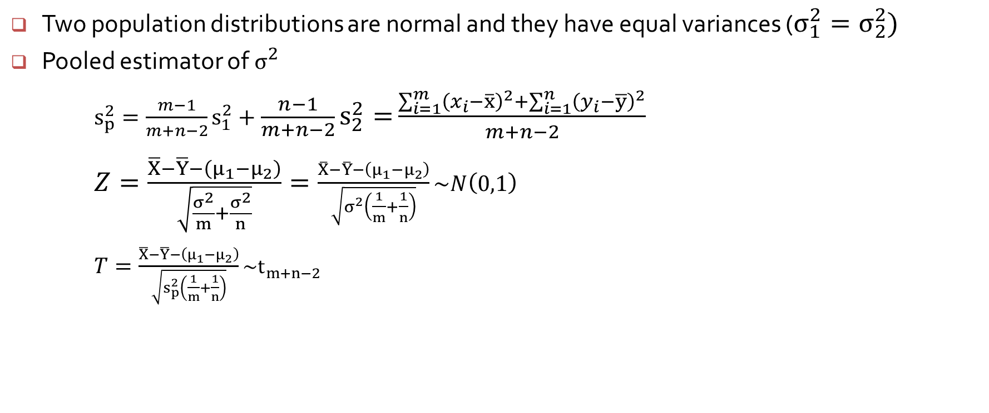
Pooled t Procedures
Two population distributions are normal and they have equal variances ($σ_{1}^{2}=σ_{2}^{2})$
Pooled estimator of $σ^{2}$
$s_{p}^{2}=\frac{m−1}{m+n−2}s_{1}^{2}+\frac{n−1}{m+n−2}s_{2}^{2}=$ $\frac{\sum_{i=1}^{m}{{\left(x_{i}−\overline{x}\right)}^{2}}+\sum_{i=1}^{n}{{\left(y_{i}−\overline{y}\right)}^{2}}}{m+n−2}$
$Z=\frac{\overline{X}−\overline{Y}−\left(μ_{1}−μ_{2}\right)}{\sqrt{\frac{σ^{2}}{m}+\frac{σ^{2}}{n}}}=\frac{\overline{X}−\overline{Y}−\left(μ_{1}−μ_{2}\right)}{\sqrt{σ^{2}\left(\frac{1}{m}+\frac{1}{n}\right)}}\sim N\left(0,1\right)$
$T=\frac{\overline{X}−\overline{Y}−\left(μ_{1}−μ_{2}\right)}{\sqrt{s_{p}^{2}\left(\frac{1}{m}+\frac{1}{n}\right)}}\sim t_{m+n−2}$

Slide 2
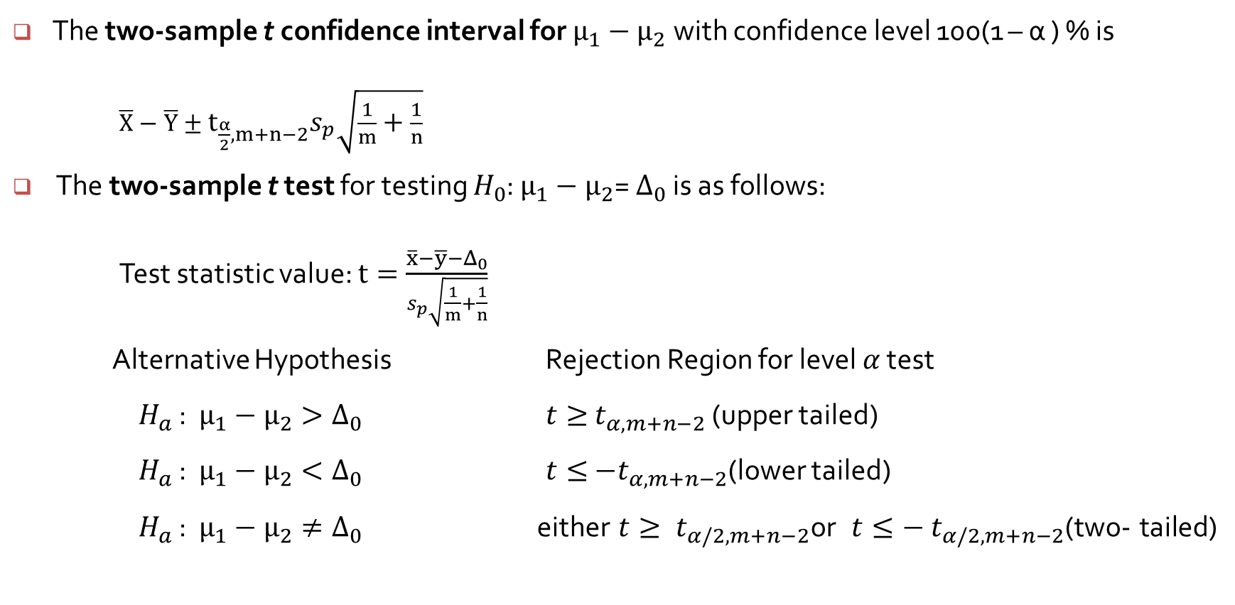
The Two-Sample t Test and Confidence Interval
The two-sample t confidence interval for $μ_{1}−μ_{2}$ with confidence level 100(1 – α ) % is
$\overline{X}−\overline{Y}±t_{\frac{α}{2},m+n−2}s_{p}\sqrt{\frac{1}{m}+\frac{1}{n}}$
The two-sample t test for testing $H_{0}$: $μ_{1}−μ_{2}$= $Δ_{0}$ is as follows:
Test statistic value: $t=\frac{\overline{x}−\overline{y}−Δ_{0}}{s_{p}\sqrt{\frac{1}{m}+\frac{1}{n}}}$
Alternative Hypothesis Rejection Region for level $α$ test
$H_{a}$ : $μ_{1}−μ_{2}>Δ_{0}$ $t≥{ t}_{α,m+n−2}$ (upper tailed)
$H_{a}$ : $μ_{1}−μ_{2}<Δ_{0}$ $t≤{ −t}_{α,m+n−2}$(lower tailed)
$H_{a}$ : $μ_{1}−μ_{2}≠Δ_{0}$ either $t≥{ t}_{α/2,m+n−2}\text{or}$ $t≤−{ t}_{α/2,m+n−2}$(two- tailed)

Slide 3
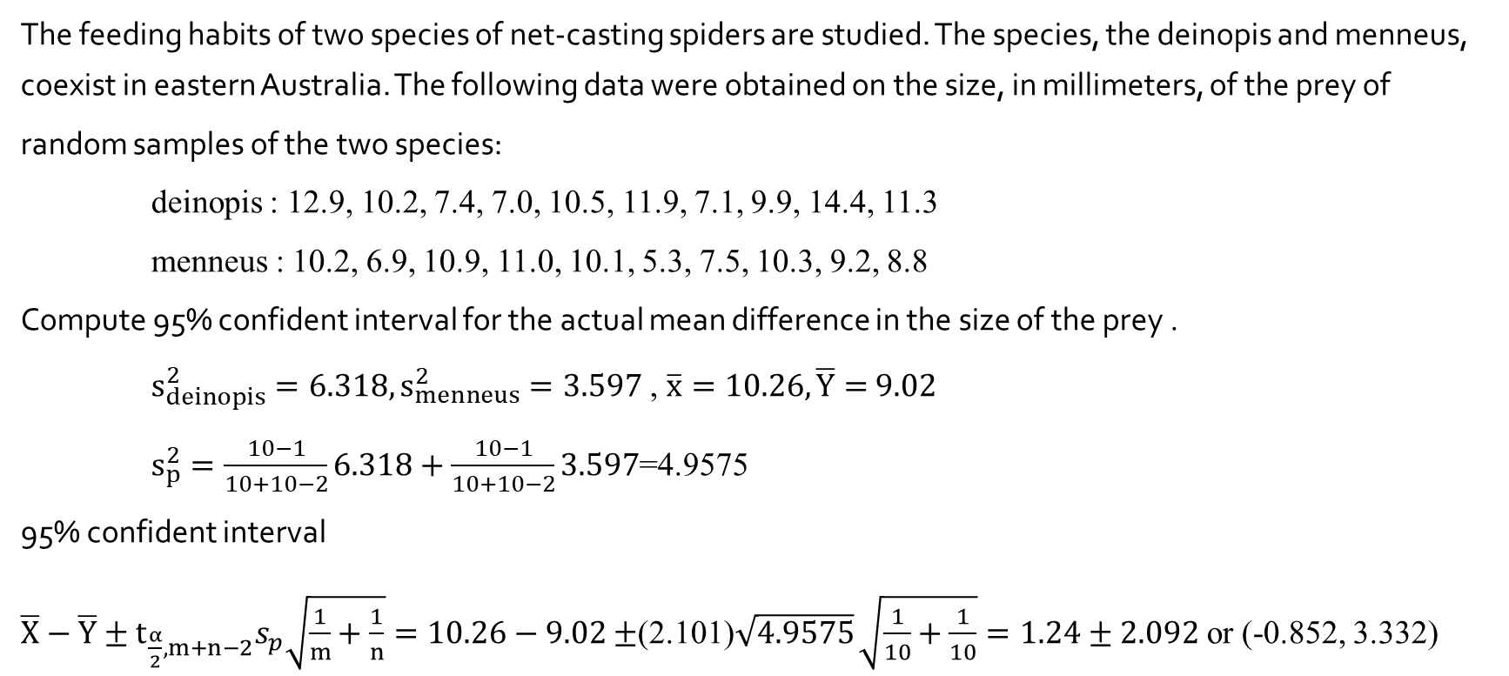
Example (https://online.stat.psu.edu/stat414/node/201/)
The feeding habits of two species of net-casting spiders are studied. The species, the deinopis and menneus, coexist in eastern Australia. The following data were obtained on the size, in millimeters, of the prey of
random samples of the two species:
deinopis : 12.9, 10.2, 7.4, 7.0, 10.5, 11.9, 7.1, 9.9, 14.4, 11.3
menneus : 10.2, 6.9, 10.9, 11.0, 10.1, 5.3, 7.5, 10.3, 9.2, 8.8
Compute 95% confident interval for the actual mean difference in the size of the prey .
$s_{deinopis}^{2}=6.318, s_{menneus}^{2}=3.597$ , $\overline{x}=10.26, \overline{Y}=$ $9.02$
$s_{p}^{2}=\frac{10−1}{10+10−2}6.318+\frac{10−1}{10+10−2}3.597$=4.9575
95% confident interval
$\overline{X}−\overline{Y}±t_{\frac{α}{2},m+n−2}s_{p}\sqrt{\frac{1}{m}+\frac{1}{n}}=10.26−9.02$ $±$(2.101)$\sqrt{4.9575}$ $\sqrt{\frac{1}{10}+\frac{1}{10}}=1.24±2.092$or (-0.852, 3.332)

Slide 4
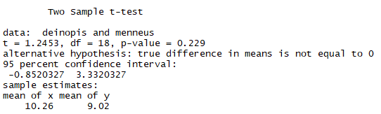

> deinopis <- c(12.9, 10.2, 7.4, 7.0, 10.5, 11.9, 7.1, 9.9, 14.4, 11.3)
> menneus <- c(10.2, 6.9, 10.9, 11.0, 10.1, 5.3, 7.5, 10.3, 9.2, 8.8)
> t.test(deinopis, menneus, var.equal=T)
$H_{0}$ : $μ_{1}−μ_{2}=0 vs H_{a}\text{ : }μ_{1}−μ_{2}≠0$
P-value : P($t_{18}<−1.2453)+$ P($t_{18}>1.2453)=0.229$
> pt(-1.2453, 18)+(1-pt(1.2453, 18)) # 0.229
$t=\frac{\overline{X}−\overline{Y}−(μ_{1}−μ_{2})}{s_{p}\sqrt{\frac{1}{m}+\frac{1}{n}}}=\frac{10.26−9.02}{\sqrt{4.9575} \sqrt{\frac{1}{10}+\frac{1}{10}}}=1.2453$

Slide 5
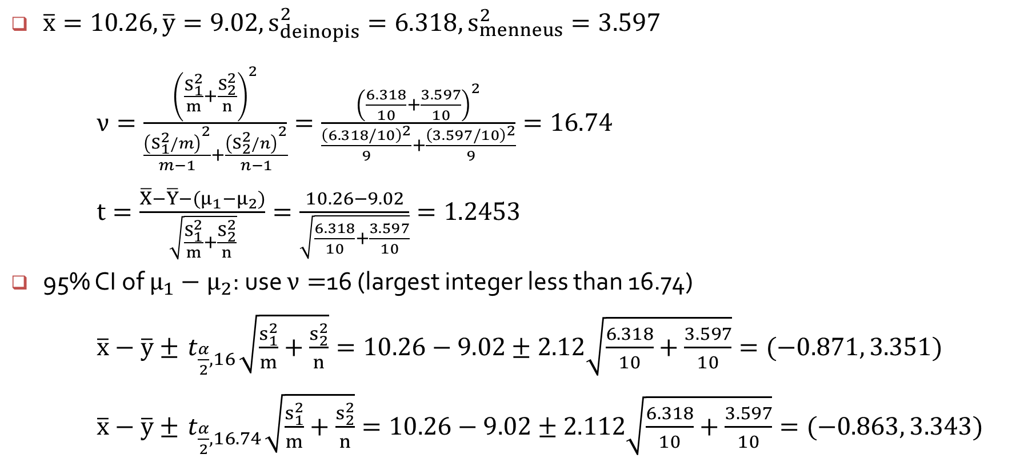
Suppose the variances are different
$\overline{x}=10.26, \overline{y}=9.02, s_{deinopis}^{2}=6.318, s_{menneus}^{2}=3.597$
$ν=\frac{{\left(\frac{S_{1}^{2}}{m}+\frac{S_{2}^{2}}{n}\right)}^{2}}{\frac{{\left(S_{1}^{2}/m\right)}^{2}}{m−1}+\frac{{\left(S_{2}^{2}/n\right)}^{2}}{n−1}}=\frac{{\left(\frac{6.318}{10}+\frac{3.597}{10}\right)}^{2}}{\frac{{\left(6.318/10\right)}^{2}}{9}+\frac{{\left(3.597/10\right)}^{2}}{9}}=16.74$
$t=\frac{\overline{X}−\overline{Y}−(μ_{1}−μ_{2})}{\sqrt{\frac{S_{1}^{2}}{m}+\frac{S_{2}^{2}}{n}}}=\frac{10.26−9.02}{\sqrt{\frac{6.318}{10}+\frac{3.597}{10}}}=1.2453$
95% CI of $μ_{1}−μ_{2}$: use $ν=$16 (largest integer less than 16.74)
$\overline{x}−\overline{y}±{ t}_{\frac{α}{2},16}\sqrt{\frac{s_{1}^{2}}{m}+\frac{s_{2}^{2}}{n}}=10.26−9.02±2.12\sqrt{\frac{6.318}{10}+\frac{3.597}{10}}=(−0.871, 3.351)$
$\overline{x}−\overline{y}±{ t}_{\frac{α}{2},16.74}\sqrt{\frac{s_{1}^{2}}{m}+\frac{s_{2}^{2}}{n}}=10.26−9.02±2.112\sqrt{\frac{6.318}{10}+\frac{3.597}{10}}=(−0.863, 3.343)$

Slide 6
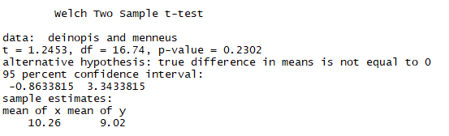

> deinopis <- c(12.9, 10.2, 7.4, 7.0, 10.5, 11.9, 7.1, 9.9, 14.4, 11.3)
> menneus <- c(10.2, 6.9, 10.9, 11.0, 10.1, 5.3, 7.5, 10.3, 9.2, 8.8)
> t.test(deinopis, menneus)
$H_{0}$ : $μ_{1}−μ_{2}=0 vs H_{a}\text{ : }μ_{1}−μ_{2}≠0$
P-value : P($t_{16.74}<−1.2453)+$ P($t_{16.74}>1.2453)=0.2302$
> pt(-1.2453, $16.74$)+(1-pt(1.2453, $16.74$)) # 0.2302

